Slide 1


Restaurant Waiter Bot
By
Nyi Nyi Myo Zin Htet ID - 5918154
Zin Zar Zar Lwin ID – 6017672
Advisor – Dr. Amulya Bhattarai

Slide 2

Content
Introduction
Project Objective
Project Overview
System Layout
System Diagram
Code Flowchart Diagram
Testing and Result
Issues and Problem
Conclusion

Slide 3
Introduction
To reduce manpower in restaurant field
To fix the common waiter error (collecting wrong order)
Initially developed in recent years for the replacement of using human resources.

Slide 4
Project Objective
Waiter machine is capability of receiving the order information from the kitchen and customer table
To reach out the designated table, the machine is following the marked line on the floor and going through the corresponding table
Obstacle blocking in front of the waiter machine, the bot would calculate the distance of the object from the machine and optimize how it will be stopped or continuously moved

Slide 5
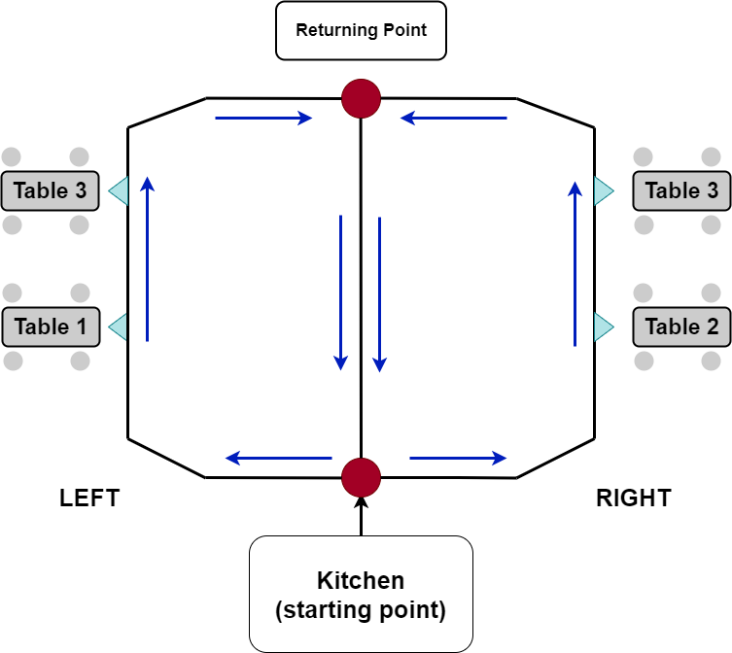
Project Overview
The waiter Bot is tracking the marked line until it arrives to the destination.
The program is implemented by Raspberry Pi3.

Slide 6
System Layout
System Layout
Kitchen

Slide 7
System Layout

Slide 8
System Layout
STOP

Slide 9
Input
(Order Table Number)
Run
Python Code
Follow the
Line Path
Motor Driver
DC motor
If there is no obstacle
If there is obstacle
To Kitchen (END)
Destination (Table)
Wheels are Moving forward
Detect the object and measure the distance
Motor Driver
DC
Motor
Wheels are stopping

Slide 10
Use of Components
No | Component List
1 | Rasberry Pi3 Model B+
2 | Ultrasonic Sensor
3 | Infrared Sensor
4 | Gear DC Motor
5 | L298N Motor Microcontroller
6 | Lipo Battery
7 | Car Chassis
8 | NodeMCU
9 | Jumper Wire
10 | Wheels

Slide 11
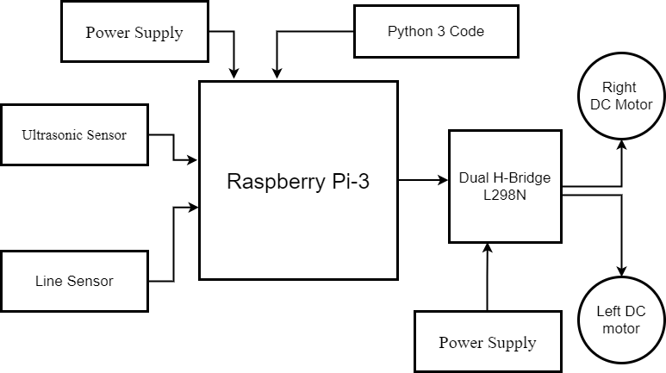
System Diagram
Overview System Diagram of Bot

Slide 12
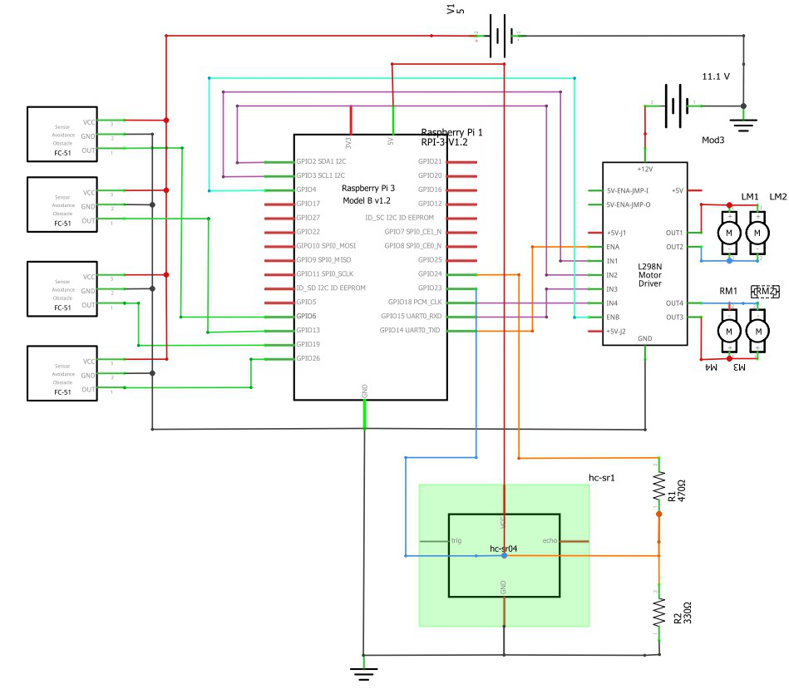
System schematic diagram

Slide 13
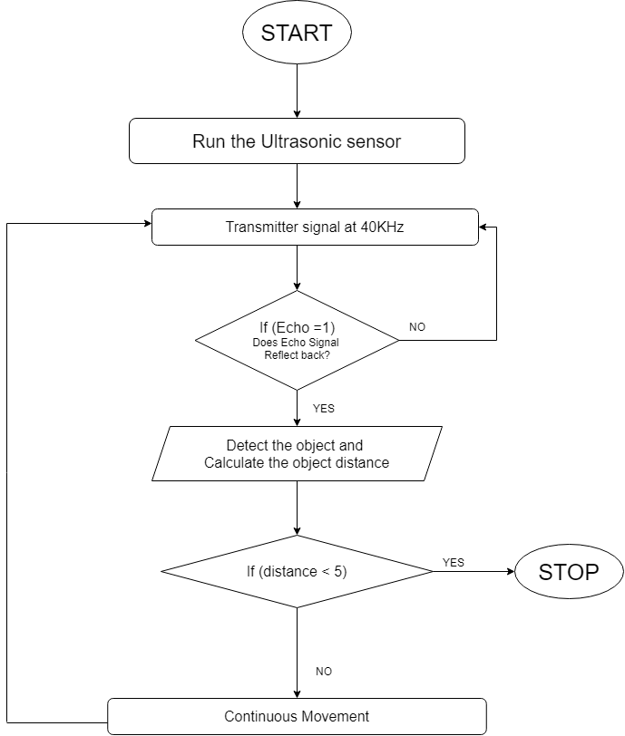
Ultrasonic Flowchart
Ultrasonic sensor Flowchart

Slide 14
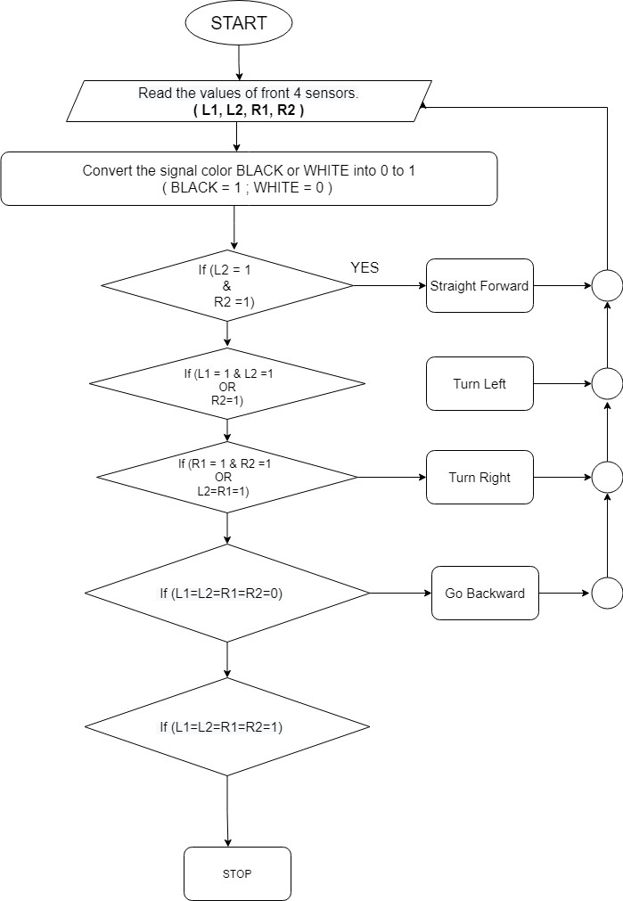
IR sensor Flowchart

Slide 15
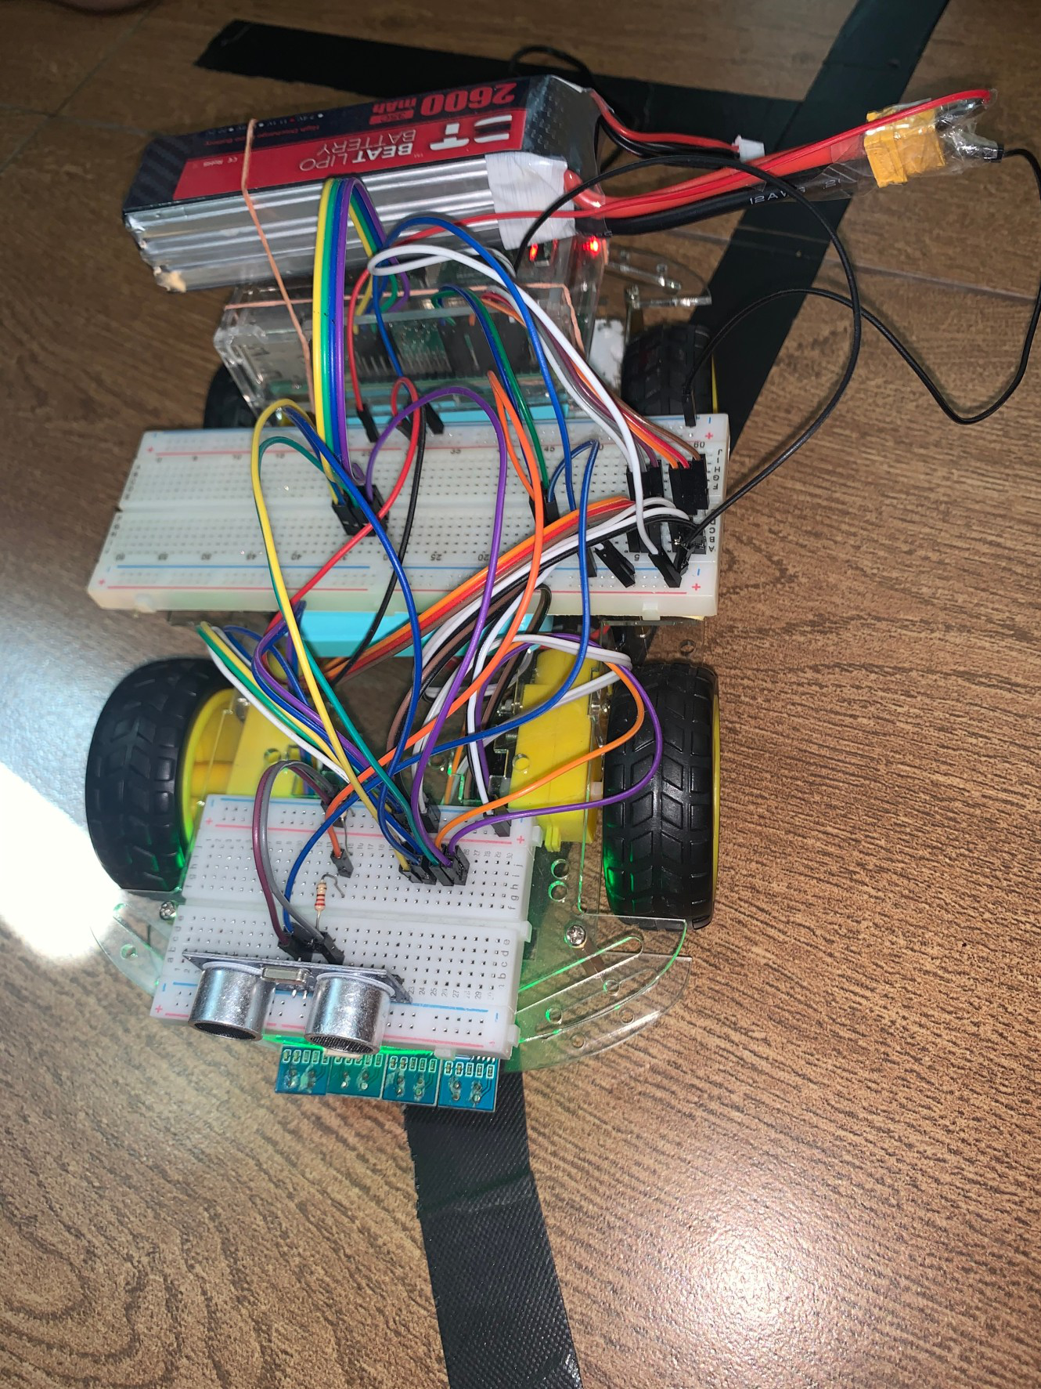
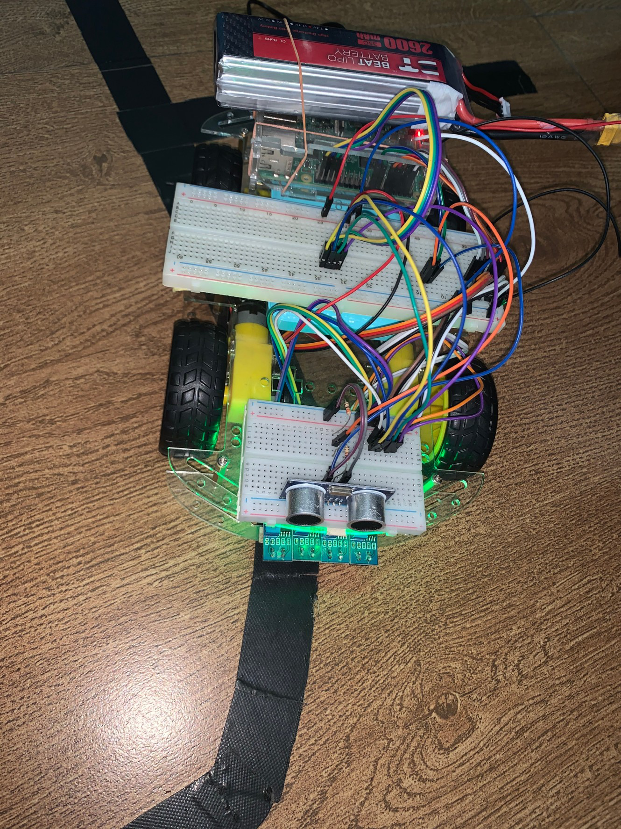
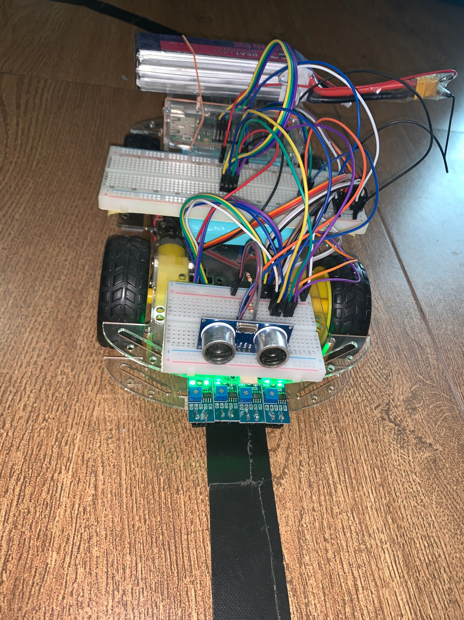
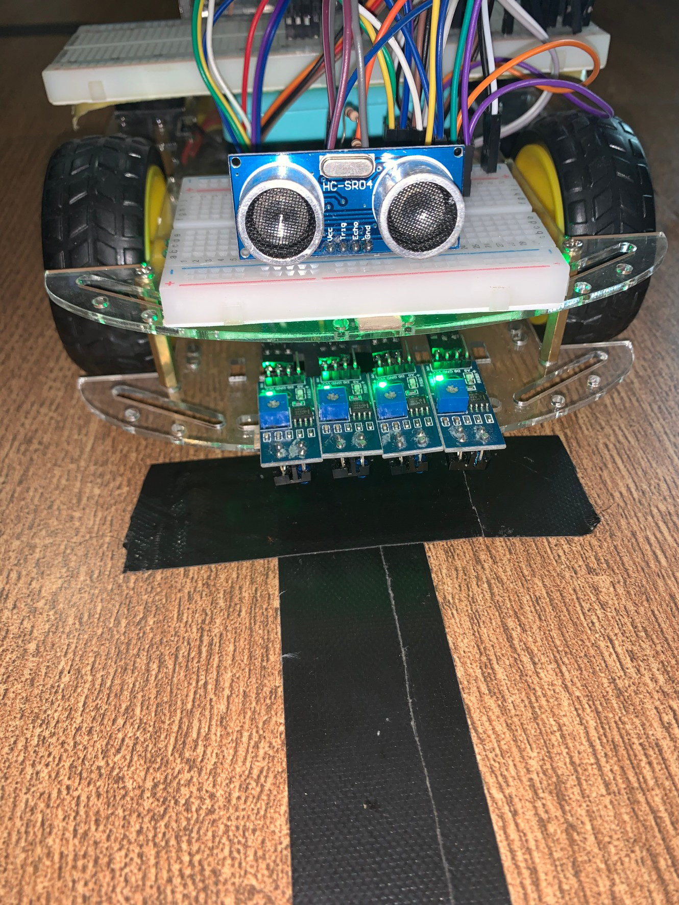
Turn Left
Turn Right
Go Forward
Stop At Table

Slide 16
Issues and Problems
Constant maintenance to the floor from any physical damage is required to be less friction.
The developer will be needed to reprogram the bot if the navigation is changed or more tables are added.
The waiter bot lacks the ability to return to the path if any external disturbance is affected upon the robot, thus the robot does not response well to any physical disturbances.

Slide 17
Conclusion
We faced many problems testing senor and testing the scenarios.
Test run a lot of time to make it less errors.
Features that we planned was not actually work so that we need to change some of the plans we need to fix and changes
Finally, run the waiter bot and serve at the table.

Slide 18
Thank You

